Slide 1


Power Up Your Configurable Apps using JavaScript 4x Functionality
Beth Romero
Kelly Hutchins
2019 ESRI DEVELOPER SUMMIT
Palm Springs, CA
Notes:
G243257 DevSummit 2019 Template for Esri staff

Slide 2

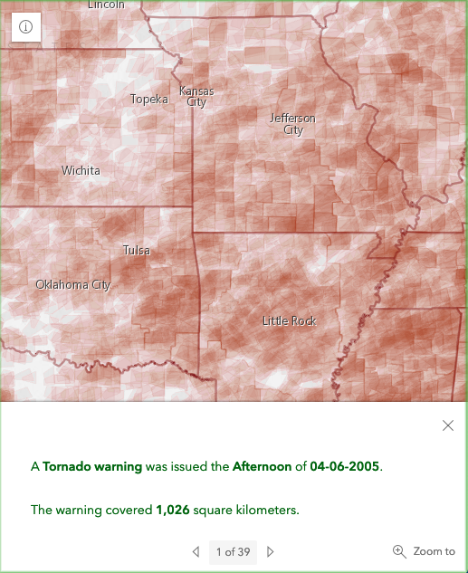
Responsive Apps
Popups
Expand/Collapse
Breakpoints

Slide 3
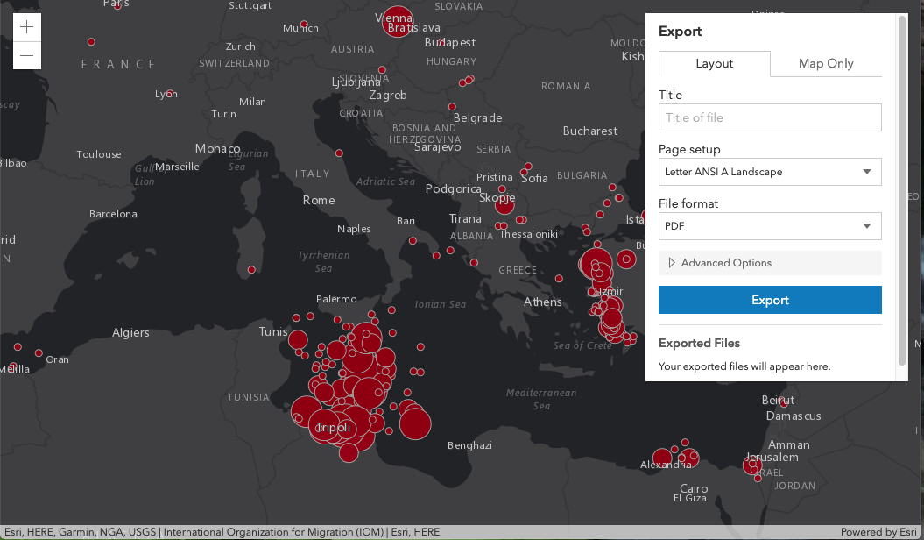
Accessibility
Notes:
I’ll create a demo video of tabbing through the 4.x widget showing they are keyboard accessible

Slide 4
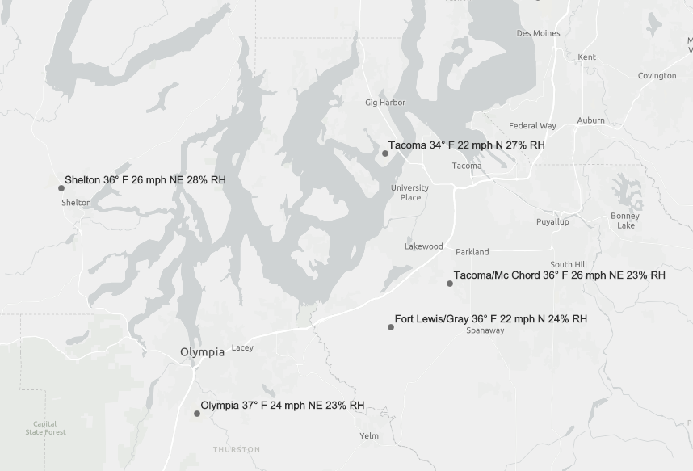
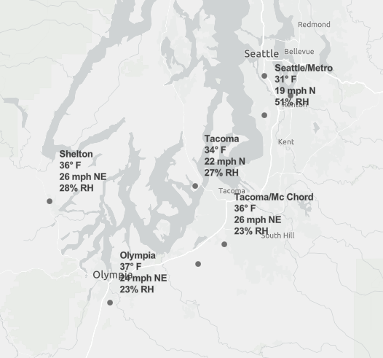
Stacked labels: Arcade new line expression
Online map viewer
4.X App
Notes:
Use new line arcade expression

Slide 5
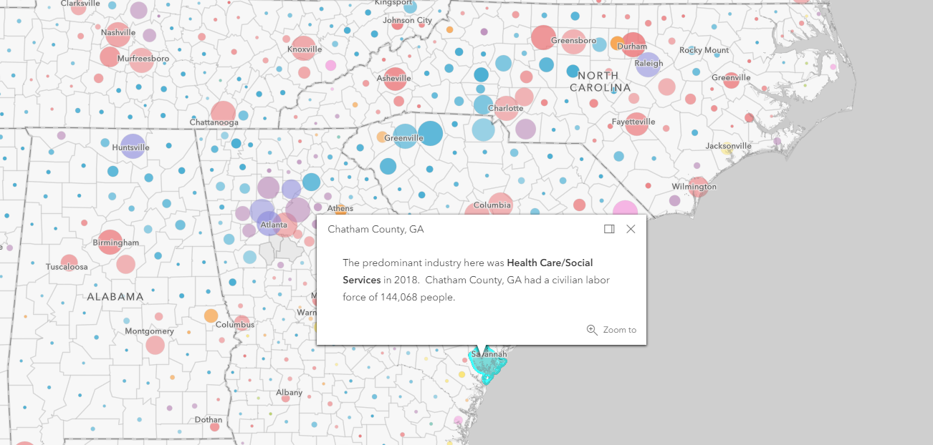
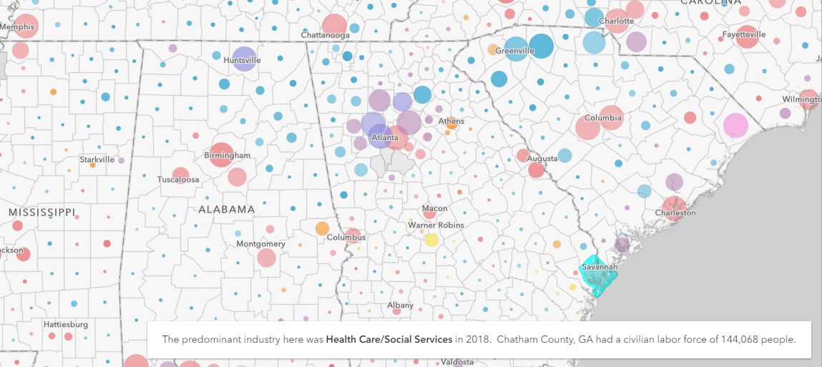
Popups : Dock and Hover
Dock
Hover
Notes:
Hover fixed popup - https://webapps.maps.arcgis.com/apps/Media/index.html?appid=99d8822351cf4513bf2b248fe3e06865
Hover floating - http://webapps.maps.arcgis.com/apps/Media/index.html?appid=4f3dd42bf668447a9abe06099f5fa457
Docked – Styler https://webapps.maps.arcgis.com/apps/Styler/index.html?appid=ba335516fee1421cb5bb449f6e9b97f5

Slide 6
Popups: Arcade
Supported in 4.11
Access features from any layer in map
Show demo app with popup that has arcade expression that shows other feature info.
Notes:
Not 4.x specific but an easy way to add cool functionality
Hiding this one for now – not sure if we should show

Slide 7
Popup: Attachments
List view (default)
Preview
Notes:
We can demo this one with the new capability on devext to create photo layers. In Media app users can choose (List view or Preview).

Slide 8
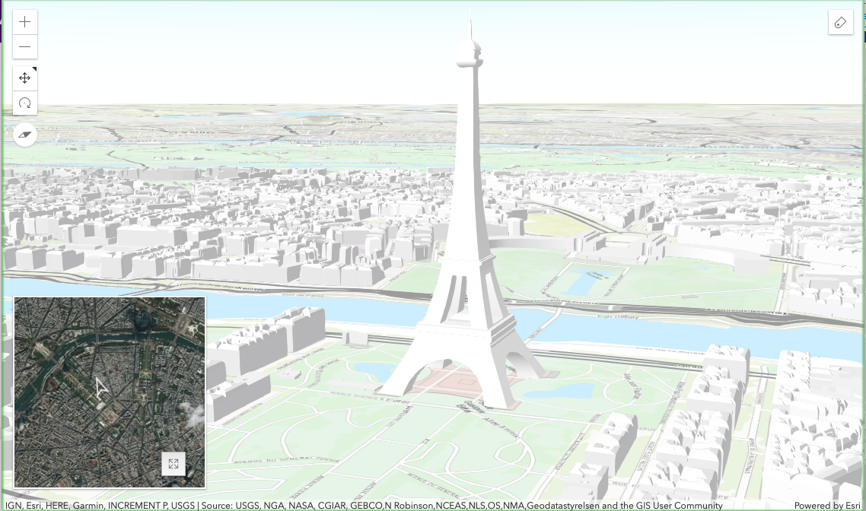
3D Maps
Compare 2d/3d
Inset 3d

Slide 9
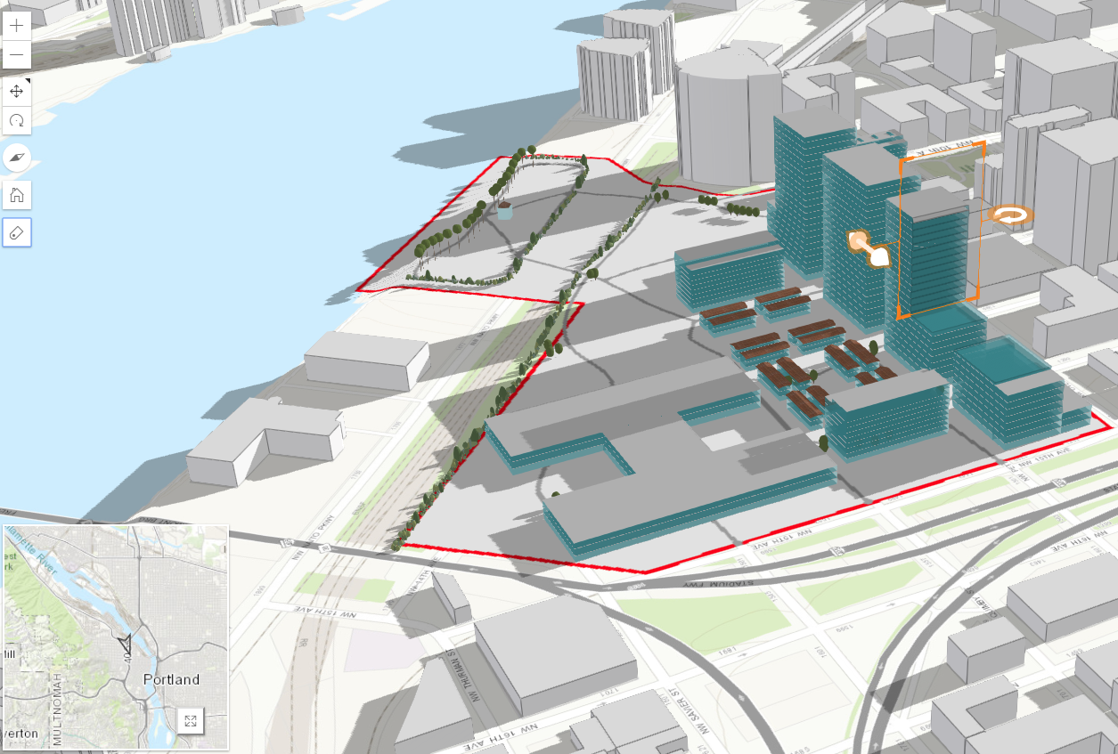
3D: Measure and Slice tools
Measure/Slice capabilities
Notes:
Slice App: Remove the buildings and the shadows update
http://webapps.maps.arcgis.com/apps/3DInsetMap/index.html?appid=0f553cdc22b14a25bc5bca2ac75397c3

Slide 10
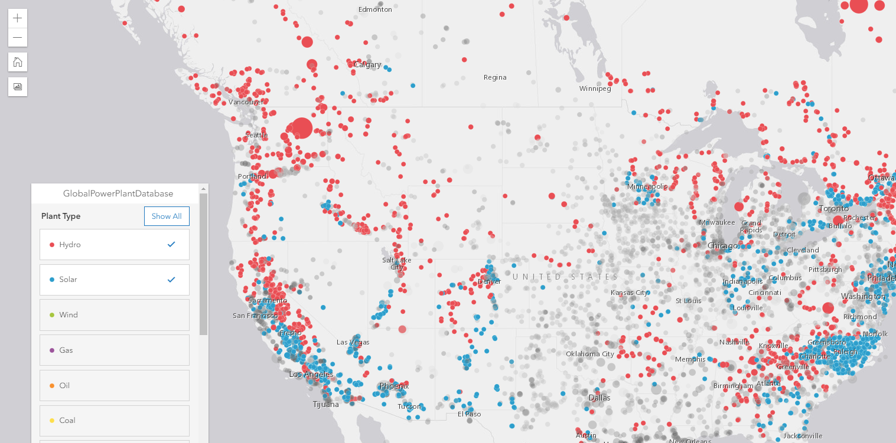
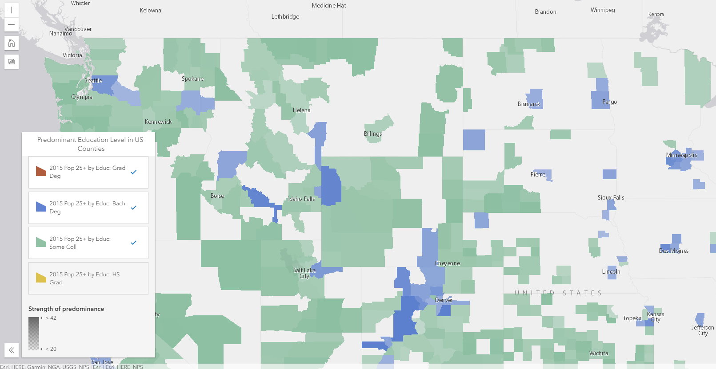
Screenshot
Demo interactive legend screenshot capability
Notes:
Mute - http://nw-brews.mapsdevext.arcgis.com/apps/InteractiveLegend/index.html?appid=c898d6031ec149068a7d5654d5fe2240
Filter - http://holistic.mapsdevext.arcgis.com/apps/InteractiveLegend/index.html?appid=c46c08cf403f4d2a92152f60fbde92a8
Other if they are updated:
– *need to update* - http://holistic.mapsdevext.arcgis.com/apps/InteractiveLegend/index.html?appid=cb78492e805848cb9e5e4f8bf3225aa2
http://holistic.mapsdevext.arcgis.com/apps/InteractiveLegend/index.html?appid=4399a2eb130c4a1f83fb3a2ce104152e
- Docked
– http://holistic.mapsdevext.arcgis.com/apps/InteractiveLegend/index.html?appid=d9e6a75521a3411bb89bb05aba60e393

Slide 11
Other widgets
Full Screen
Coords widget
Legend (card style?)
Notes:
Coords Widget - https://webapps.maps.arcgis.com/apps/Styler/index.html?appid=32412e57f2514b008740de00e77f4d2a
Legend Card Style and Full Screen - https://webapps.maps.arcgis.com/apps/Media/index.html?appid=0d609007027e41d3aff3ebcd451d3527

Slide 12
Filter
Talk about client side filtering in Interactive Legend

Slide 14
Performance ?
WebGl
Client side queries
Feature layer pbf
Notes:
https://developers.arcgis.com/javascript/latest/guide/release-notes/4.8/index.html

Slide 15


Slide 16

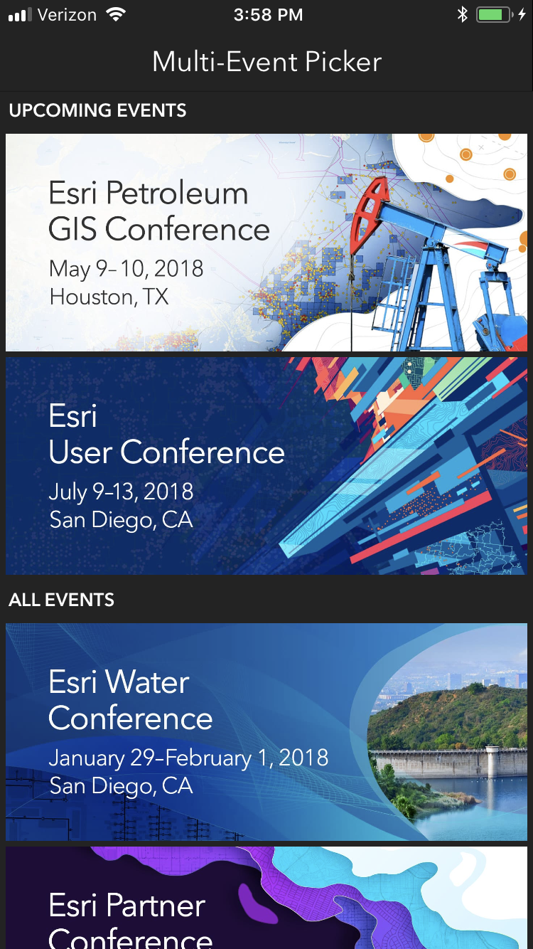
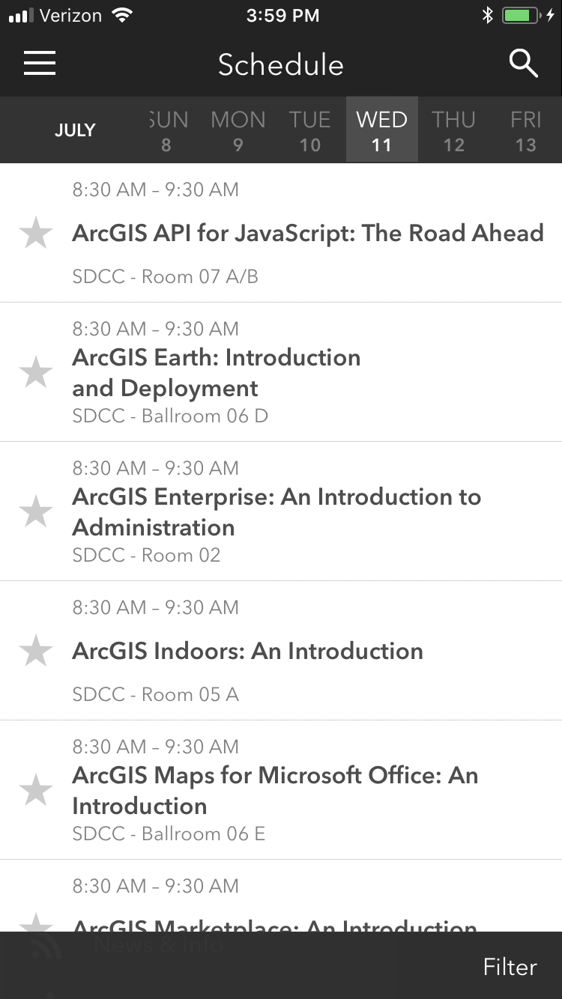
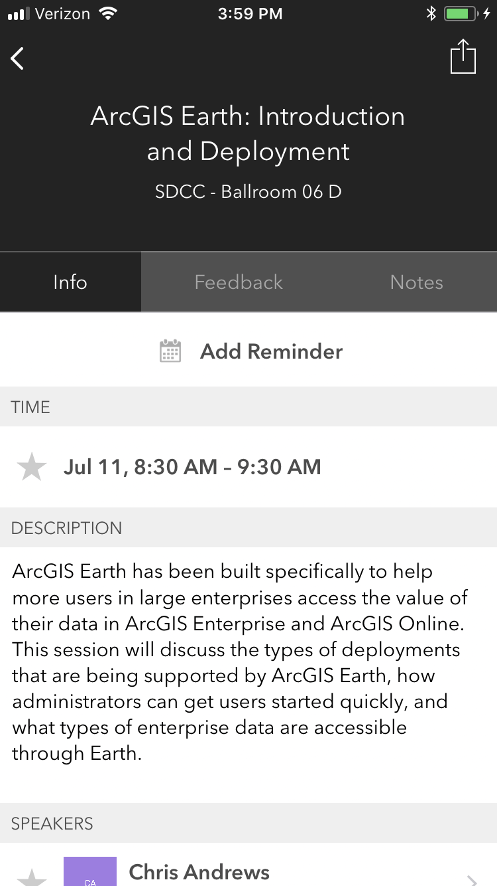
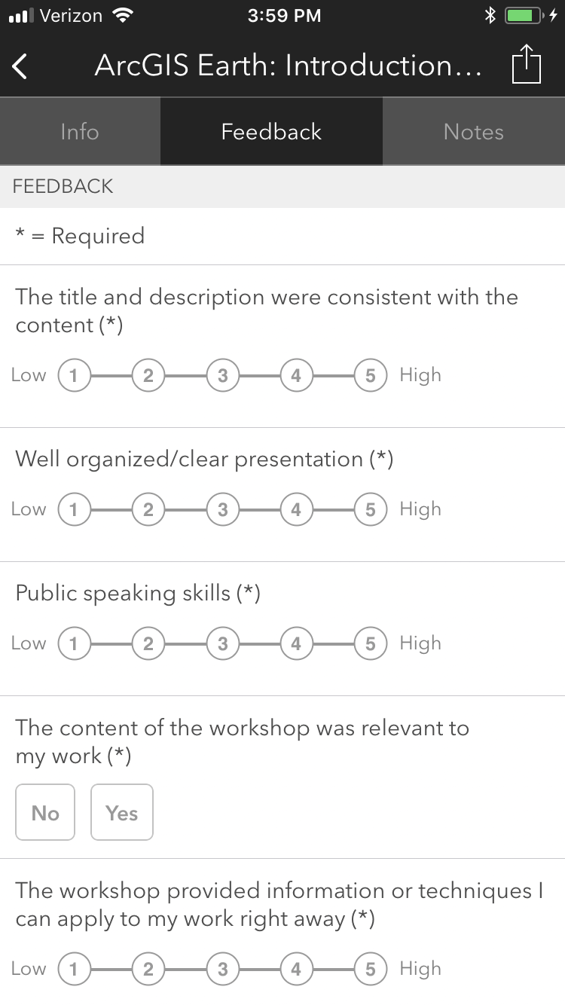
Please Take Our Survey on the App
Download the Esri Events app and find your event
Select the session you attended
Scroll down to find the feedback section
Complete answers
and select “Submit”

